Slide 1
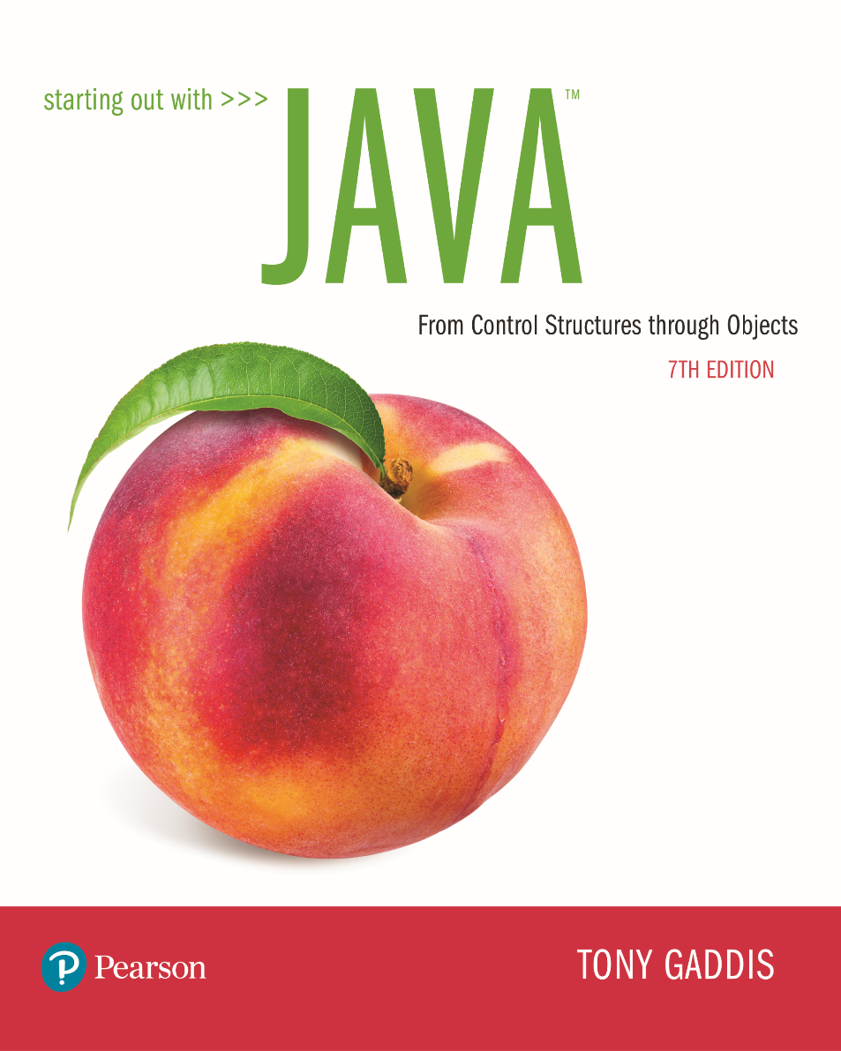

Slide 2
Examples’ Source Code
Source Code for examples presented in these slides can be found on:
Blackboard->Course Content->Source Code Of The Book Examples

Slide 3
Module Topics
Module 3 discusses the following main topics:
4.1 The Increment and Decrement Operators
4.2 The while Loop
4.3 Using the while Loop for Input Validation
4.4 The do-while Loop
4.5 The for Loop
4.6 Running Totals and Sentinel Values
4.7 Nested Loops
4.8 break and continue Statements
4.9 Deciding Which Loop to Use

Slide 4
The Increment and Decrement Operators
There are numerous times where a variable must simply be incremented or decremented.
number = number + 1;
number = number – 1;
Java provide shortened ways to increment and decrement a variable’s value.
Using the ++ or -- unary operators, this task can be completed quickly.
number++; or ++number;
number--; or --number;

Slide 5
Differences Between Prefix and Postfix
When an increment or decrement are the only operations in a statement, there is no difference between prefix and postfix notation.
number++; or ++number;
When used in an expression:
prefix notation indicates that the variable will be incremented or decremented prior to the rest of the equation being evaluated.
postfix notation indicates that the variable will be incremented or decremented after the rest of the equation has been evaluated.
int age = 20;
System.out.println(“Your age is “ + age++ + “\n”);
System.out.println(“Your age is “ + ++age + “\n”);

Slide 6
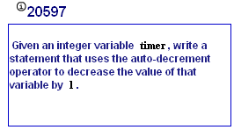
My Programming Lab 3 – 4.1

Slide 7
The while Loop
The while loop has the form:
while(condition)
{
statements;
}
While the condition is true, the statements will execute repeatedly.
The while loop is a pretest loop, which means that it will test the value of the condition prior to executing the loop.

Slide 8
The while Loop
Care must be taken to set the condition to false somewhere in the loop so the loop will end.
Loops that do not end are called infinite loops.
A while loop executes 0 or more times. If the condition is false, the loop will not execute.
Example: WhileLoop.java

Slide 9
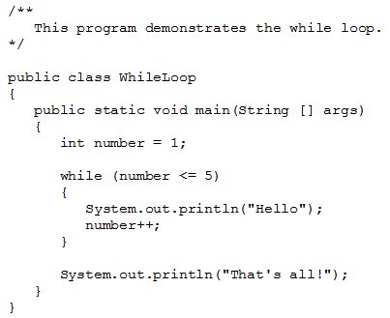

Slide 10
The while loop Flowchart
true
boolean
expression?
statement(s)
false

Slide 11
Infinite Loops
How could this problem be solved?
while (x-- > 0) or . . .
In order for a while loop to end, the condition must become false. The following loop will not end:
int x = 20;
while(x > 0)
{
System.out.println("x is greater than 0");
}

Slide 12
Infinite Loops
This version of the loop decrements x during each iteration:
int x = 20;
while(x > 0)
{
System.out.println("x is greater than 0");
x--;
}

Slide 13
Block Statements in Loops
Curly braces are required to enclose block statement while loops. (like block if statements)
while (condition)
{
statement;
statement;
statement;
}

Slide 14
The while Loop for Input Validation
Input validation is the process of ensuring that user input is valid.
System.out.print("Enter a number in the " +
"range of 1 through 100: ");
number = keyboard.nextInt();
// Validate the input.
while (number < 1 || number > 100)
{
System.out.println("That number is invalid.");
System.out.print("Enter a number in the " +
"range of 1 through 100: ");
number = keyboard.nextInt();
}
Example: SoccerTeams.java

Slide 15
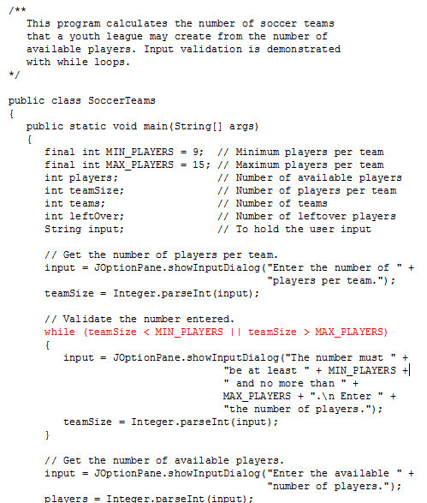

Slide 16
The do-while Loop
The do-while loop is a post-test loop, which means it will execute the loop prior to testing the condition.
The do-while loop (sometimes called called a do loop) takes the form:
do
{
statement(s);
}while (condition);
Example: TestAverage1.java

Slide 17
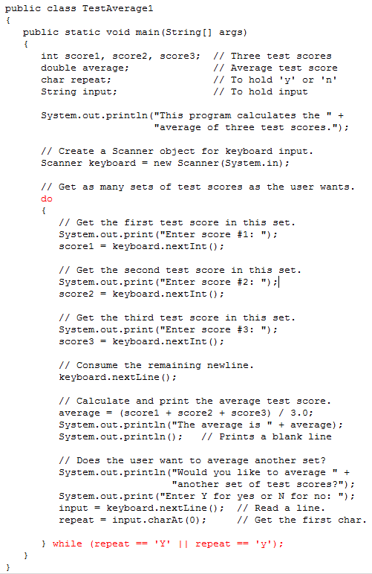

Slide 18
The do-while Loop Flowchart
statement(s)
true
boolean
expression?
false

Slide 19
The for Loop
The for loop is a pre-test loop.
The for loop allows the programmer to initialize a control variable, test a condition, and modify the control variable all in one line of code.
The for loop takes the form:
for(initialization; test; update)
{
statement(s);
}
See example: Squares.java

Slide 20

The for Loop

Slide 21
The for Loop Flowchart
boolean
expression?
true
statement(s)
update
false

Slide 22
The Sections of The for Loop
The initialization section of the for loop allows the loop to initialize its own control variable.
The test section of the for statement acts in the same manner as the condition section of a while loop.
The update section of the for loop is the last thing to execute at the end of each loop.
Example: UserSquares.java

Slide 23
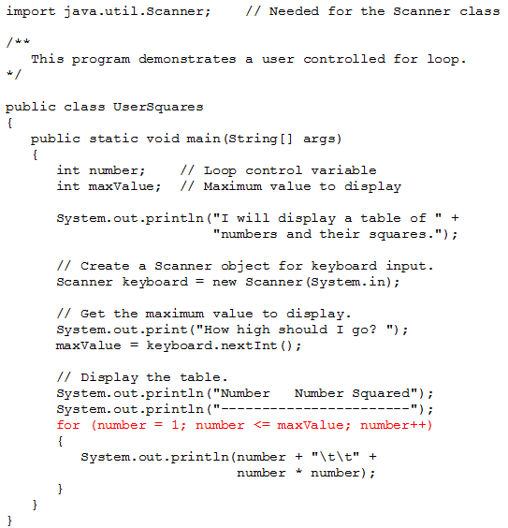

Slide 24
The for Loop Initialization
The initialization section of a for loop is optional; however, it is usually provided.
Typically, for loops initialize a counter variable that will be tested by the test section of the loop and updated by the update section.
The initialization section can initialize multiple variables.
Variables declared in this section have scope only for the for loop.

Slide 25
The Update Expression
The update expression is usually used to increment or decrement the counter variable(s) declared in the initialization section of the for loop.
The update section of the loop executes last in the loop.
The update section may update multiple variables.
Each variable updated is executed as if it were on a line by itself.

Slide 26
Modifying The Control Variable
You should avoid updating the control variable of a for loop within the body of the loop.
The update section should be used to update the control variable.
Updating the control variable in the for loop body leads to hard to maintain code and difficult debugging.

Slide 27
Multiple Initializations and Updates
The for loop may initialize and update multiple variables.
for(int i = 5, int j = 0; i < 10 || j < 20; i++, j+=2)
{
statement(s);
}
Note that the only parts of a for loop that are mandatory are the semicolons.
for(;;)
{
statement(s);
} // infinite loop
If left out, the test section defaults to true.

Slide 28
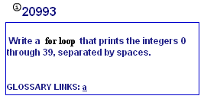
My Programming Lab 3 – 4.5

Slide 29
Running Totals
Loops allow the program to keep running totals while evaluating data.
Imagine needing to keep a running total of user input.
Example: TotalSales.java

Slide 30
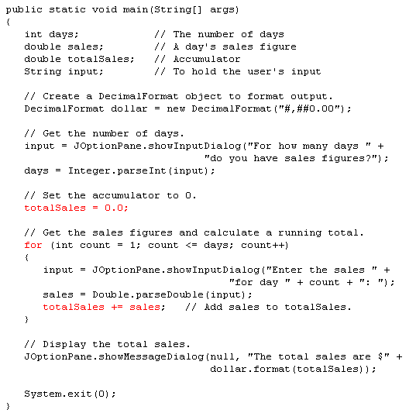

Slide 31
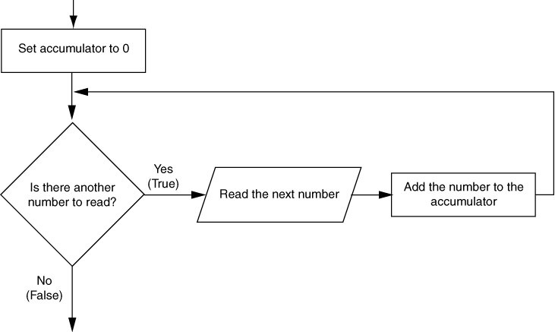
Logic for Calculating a Running Total

Slide 32
Sentinel Values
Sometimes the end point of input data is not known.
A sentinel value can be used to notify the program to stop acquiring input.
If it is a user input, the user could be prompted to input data that is not normally in the input data range (i.e. –1 where normal input would be positive.)
Programs that get file input typically use the end-of-file marker to stop acquiring input data.
Example: SoccerPoints.java

Slide 33
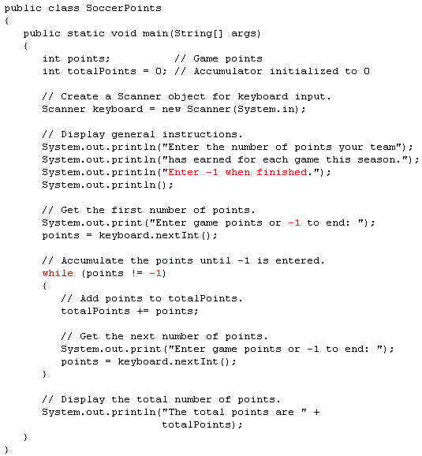

Slide 34
Nested Loops
Like if statements, loops can be nested.
If a loop is nested, the inner loop will execute all of its iterations for each time the outer loop executes once.
for(int i = 0; i < 10; i++)
for(int j = 0; j < 10; j++)
loop statements;
The loop statements in this example will execute 100 times.
Example: Clock.java

Slide 35
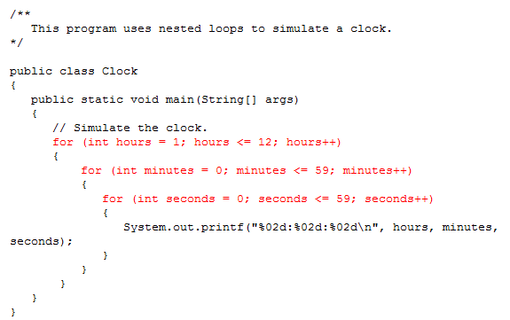

Slide 36
The break Statement
The break statement can be used to abnormally terminate a loop.
The break statement immediately leaves the block it is currently in (except if blocks)
The use of the break statement in loops bypasses the normal mechanisms and makes the code hard to read and maintain.
It is considered bad form to use the break statement in this manner.

Slide 37
The continue Statement
The continue statement will cause the currently executing iteration of a loop to terminate and the next iteration will begin.
The continue statement will cause the evaluation of the condition in while and for loops.
Like the break statement, the continue statement should be avoided because it makes the code hard to read and debug.

Slide 38
Deciding Which Loops to Use
The while loop:
Pretest loop
Use it where you do not want the statements to execute if the condition is false in the beginning.
The do-while loop:
Post-test loop
Use it where you want the statements to execute at least one time.
The for loop:
Pretest loop
Use it where there is some type of counting variable that can be evaluated.

